Slide 1

Team Shiva
Our dedicated team is passionate about creating a digital companion tailored for expectant mothers.
Team Details :
Aman Chauhan (22BCE0476)
Tanmay Mishra (22BEC0067)
Vasu Johri (22BEC0978)
Isha Agrawal (22BBS0145)

Slide 2

Problem Addressed
Lack of Personalized Support
Information Overload
Expectant mothers often struggle to find personalized support and guidance tailored to their specific needs and concerns during pregnancy.
The abundance of pregnancy-related information online can be overwhelming, leading to confusion and uncertainty for expectant mothers.
Healthcare Accessibility
Fetal Health Support
Not all expectant mothers have easy access to healthcare professionals for regular check-ups and support, especially in remote or underserved areas.
Empowering expectant mothers with cutting-edge fetal health analysis for proactive prenatal care and optimal pregnancy outcomes

Slide 3

Solution Proposed
Fetal Distress Detection : Our digital companion utilizes machine learning algorithms to monitor fetal health parameters in real-time, empowering expectant mothers with early detection of potential distress indicators and enabling timely action in consultation with healthcare professionals
Comprehensive Maternal and Neonatal Support: Our digital companion provides personalized guidance on pregnancy, childbirth, and newborn care, offering tailored nutritional advice and promoting wellness through exercise and stress management, empowering expectant mothers with comprehensive support for optimal maternal and neonatal health.

Slide 4

Solution Proposed
Medication Analysis and Ayurvedic Alternatives:
Digital companion analyzes allopathic medicines for pregnancy, identifies active ingredients, side effects, offers Ayurvedic alternatives personalized to user preferences and medical history.
Emergency Support:
We integrate advanced AI and machine learning algorithms to provide personalized guidance and support to expectant mothers throughout their journey.

Slide 5

Research Performed to Find a Solution
Our dedicated team meticulously researched best practices in prenatal care, consulted leading obstetricians, and conducted surveys among expectant mothers to gather insights.
We analyzed the latest medical research to ensure the digital companion provides the most accurate and relevant information for expectant mothers.

Slide 6


Social Impact
Empowering Expectant Mothers
Knowledge and Autonomy
Our digital companion app aims to empower expectant mothers by providing personalized and holistic support throughout their pregnancy journey.
We provide mothers with knowledge and tools to take charge of their health and advocate for their needs during pregnancy

Slide 7

Tech Stack
Next.js
React.js
Tailwind CSS
LLM
Knowledge Base
StreamLit Community
Figma

Slide 8
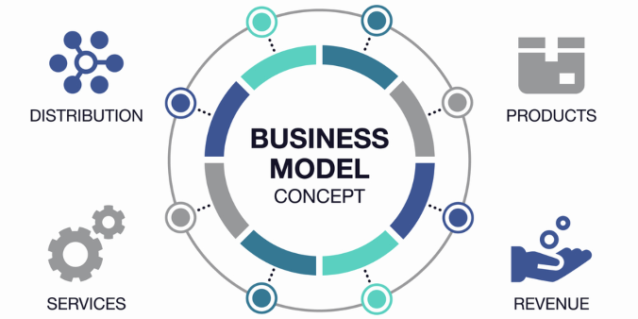
Business Model
Revenue Streams
Cost Structure
User Engagement
Growth Strategy
Our business model revolves around various revenue streams, including subscription services for advanced features, partnerships with maternity care providers, and sponsored content from trusted brands.
We have a lean cost structure, focusing on technology infrastructure, content creation, and customer support. This allows us to invest in quality without excessive overhead.
Our model prioritizes user engagement, with personalized offerings, interactive experiences, and a community-driven approach to create meaningful connections among expectant mothers.
Our growth strategy involves targeted marketing, strategic partnerships, and continuous innovation to expand our user base and deliver valuable solutions to a wider audience.

Slide 9
Financial Projection :
Initial Investment :
Revenue Stream:
Development Costs: INR 30,000
Marketing Expenses: INR 10,000
Operational Costs: INR 8000
Total Initial Investment: INR (30,000+10,000+ 8000) = INR 48,000
Subscription Fees from Partner Hospitals: INR 2000/ month
Consultation Fees from Medical Services: INR 500/consultation
Total Projected Revenue: INR( 24,000 + + 1,00,000) = INR 1,24,000

Slide 10

Conclusion
After thorough research and analysis, we are confident in the potential of our digital companion to revolutionize prenatal care. Our team's dedication to creating a holistic support system for expectant mothers will bring about a positive impact on their journey to motherhood. We are excited to witness the positive change this will bring to the lives of pregnant women around the world.

